Slide 1

Advanced Computational Physics 2
Interaction of 2 Massive Mesoswimmers at Low Reynold's Number
Christian Neureuter

Slide 2
Outline
01
Reynold‘s Number and Background
02
Scallop Theorem
03
Mesoscale Model
04
Results
05
Conclusions

Slide 3
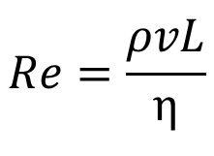
Reynold’s Number
Reynold’s number (Re) is the ratio of inertial forces to viscous forces occurring in a fluid flow.
$$Re=\frac{ρvL}{η}$$
ρ = fluid density
v = flow velocity
L = characteristic length
η = fluid viscosity
Notes:
Test note

Slide 4
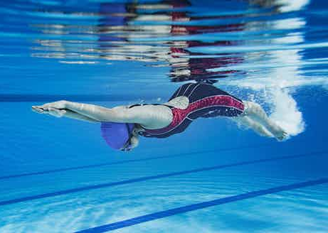
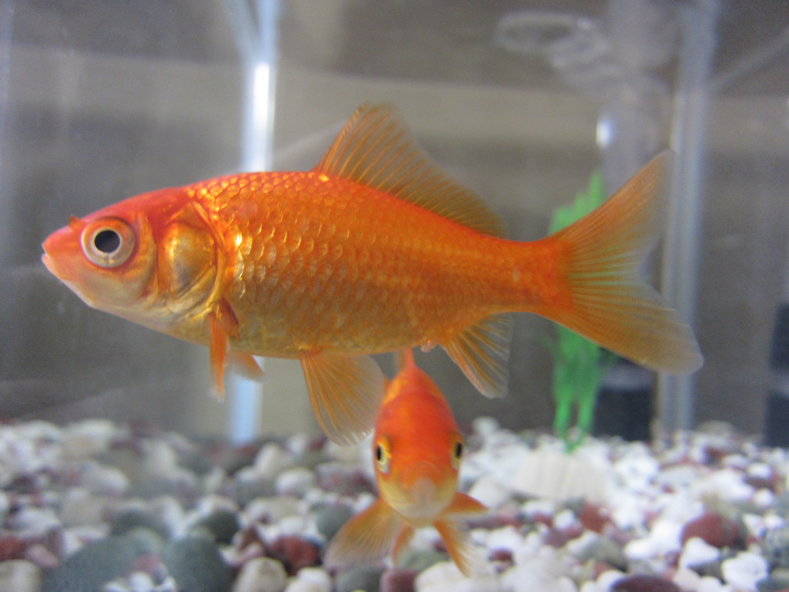

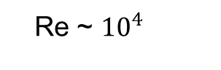


Reynold’s Number
Length Scale Dependence
Shutterstock 3-2022
Wikimedia commons 3-2022
Cleveland Clinic 3-2022
Re ~ ${10}^{4}$
Re ~ ${10}^{2}$
Re ~ ${10}^{−4}$

Slide 5
Low Reynold’s Number
“Coasting” times are on the order of μs
small swimmers have almost no inertia
What you’re doing depends almost exclusively on current forces and not past ones
Markov-like process

Slide 6
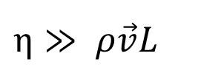
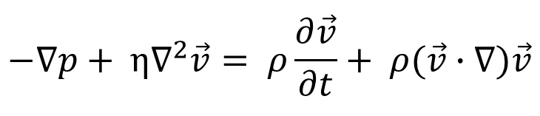
Navier-Stokes Equations
$$−∇p+ η∇^{2}\vec{v}= ρ\frac{∂\vec{v}}{∂t}+ ρ(\vec{v}∙∇)\vec{v}$$
Convective force
“Diffusion” term
Pressure gradient
Change in fluid flow
If Re << 1 then
$η≫ ρ\vec{v}L$

Slide 7
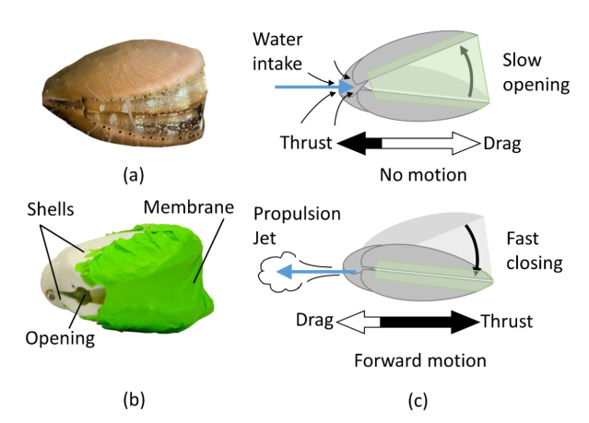
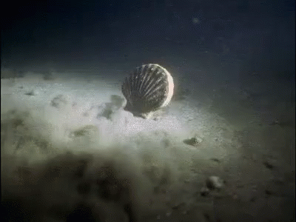
Scallop Theorem
Robertson et al. 2019

Slide 8
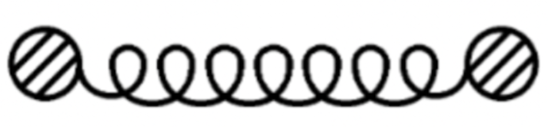
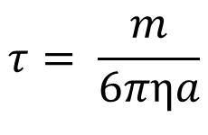
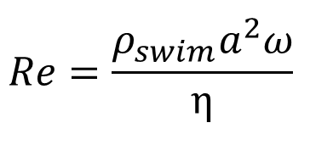
Mesoscale
100μm – 1cm
$$τ= \frac{m}{6πηa}$$
Coasting time:
$$Re=\frac{ρ_{swim}a^{2}ω}{η}$$

Slide 9
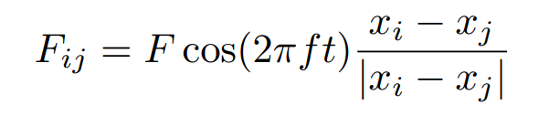
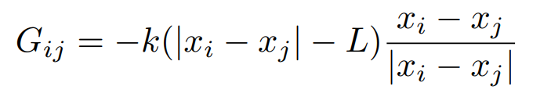
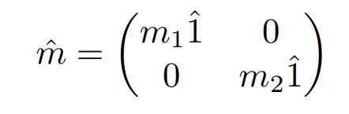
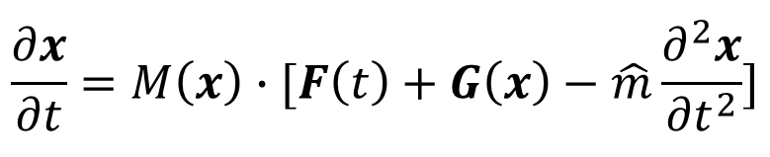
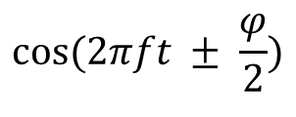
Model/Method
$$\frac{∂x}{∂t}=M\left(x\right)∙[F\left(t\right)+G\left(x\right)−\hat{m}\frac{∂^{2}x}{{∂t}^{2}}]$$
$$cos⁡(2πft ± \frac{φ}{2})$$
Relative phase shift between swimmers

Slide 10
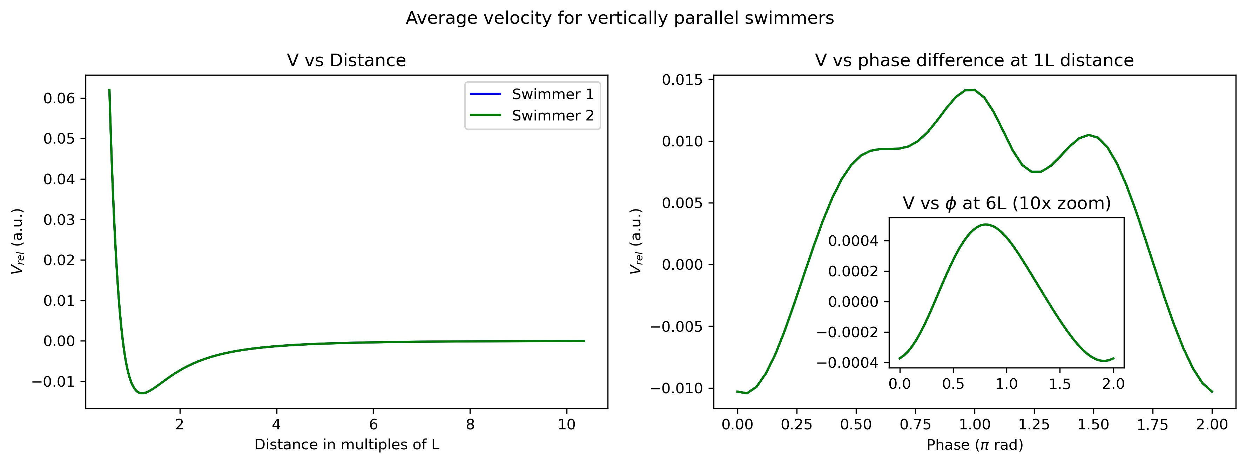
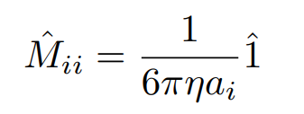
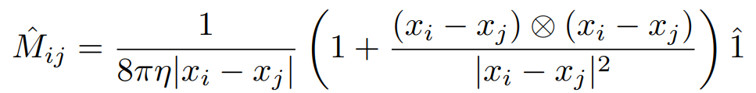
Oseen Tensor
Hydrodynamic Interaction Tensor
Notice how it diverges quickly at distances less than 1L
Vertically Parallel Swimmers

Slide 11
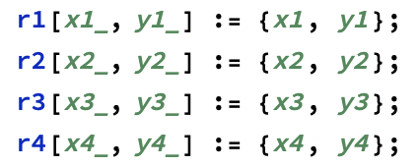
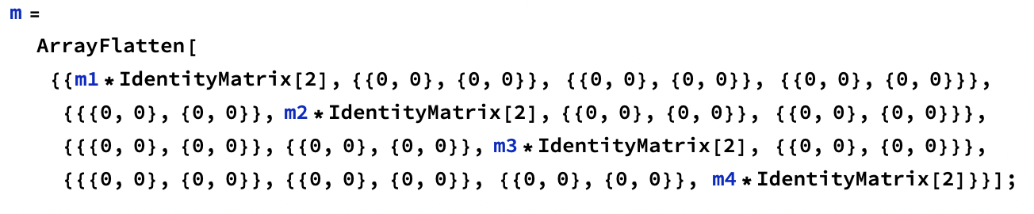
Method

Slide 12
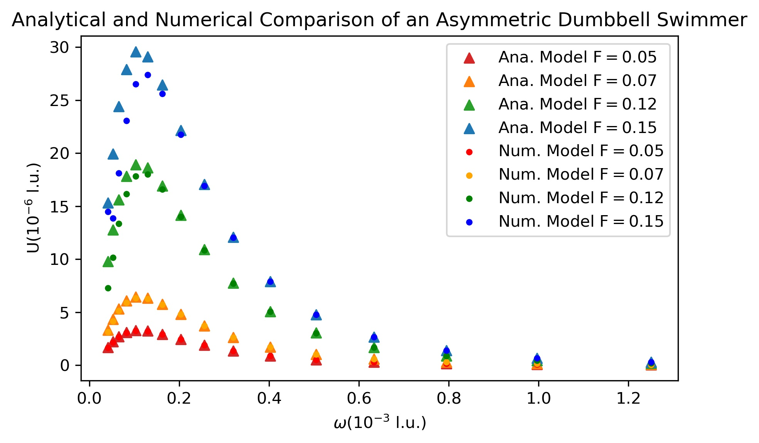
Results
1D 1 Swimmer

Slide 13
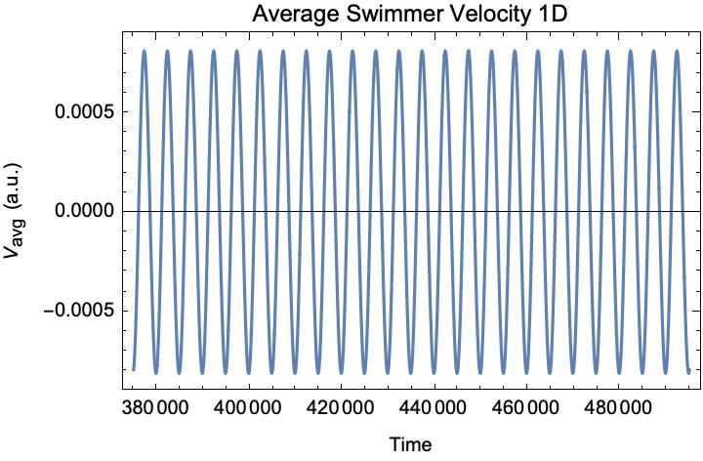
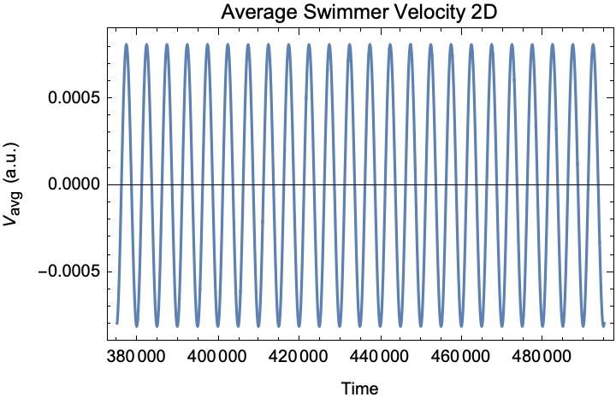
Results
2D 1 Swimmer

Slide 14
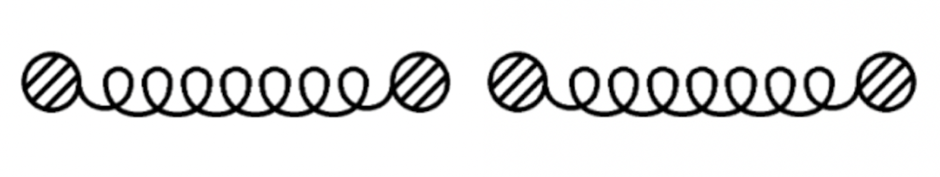
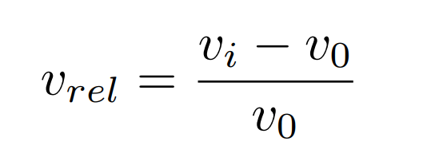
Results
2D 2 Swimmer
Configurations
Perpendicular
Vertically Parallel
Parallel Side-by-Side
Relative velocity

Slide 15
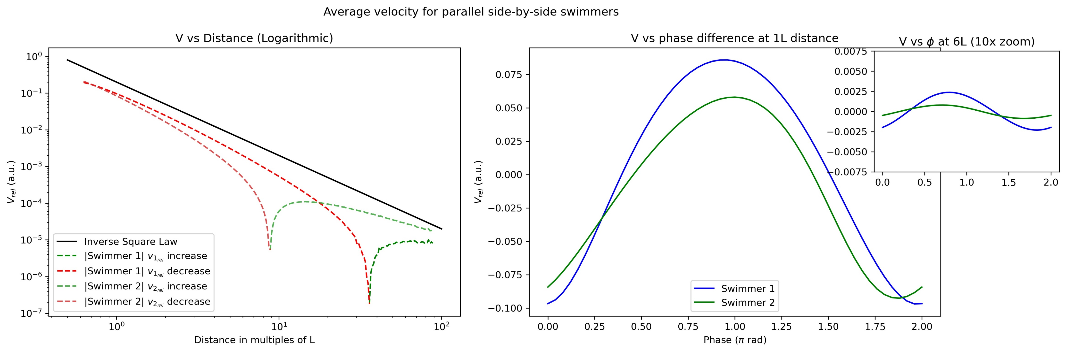
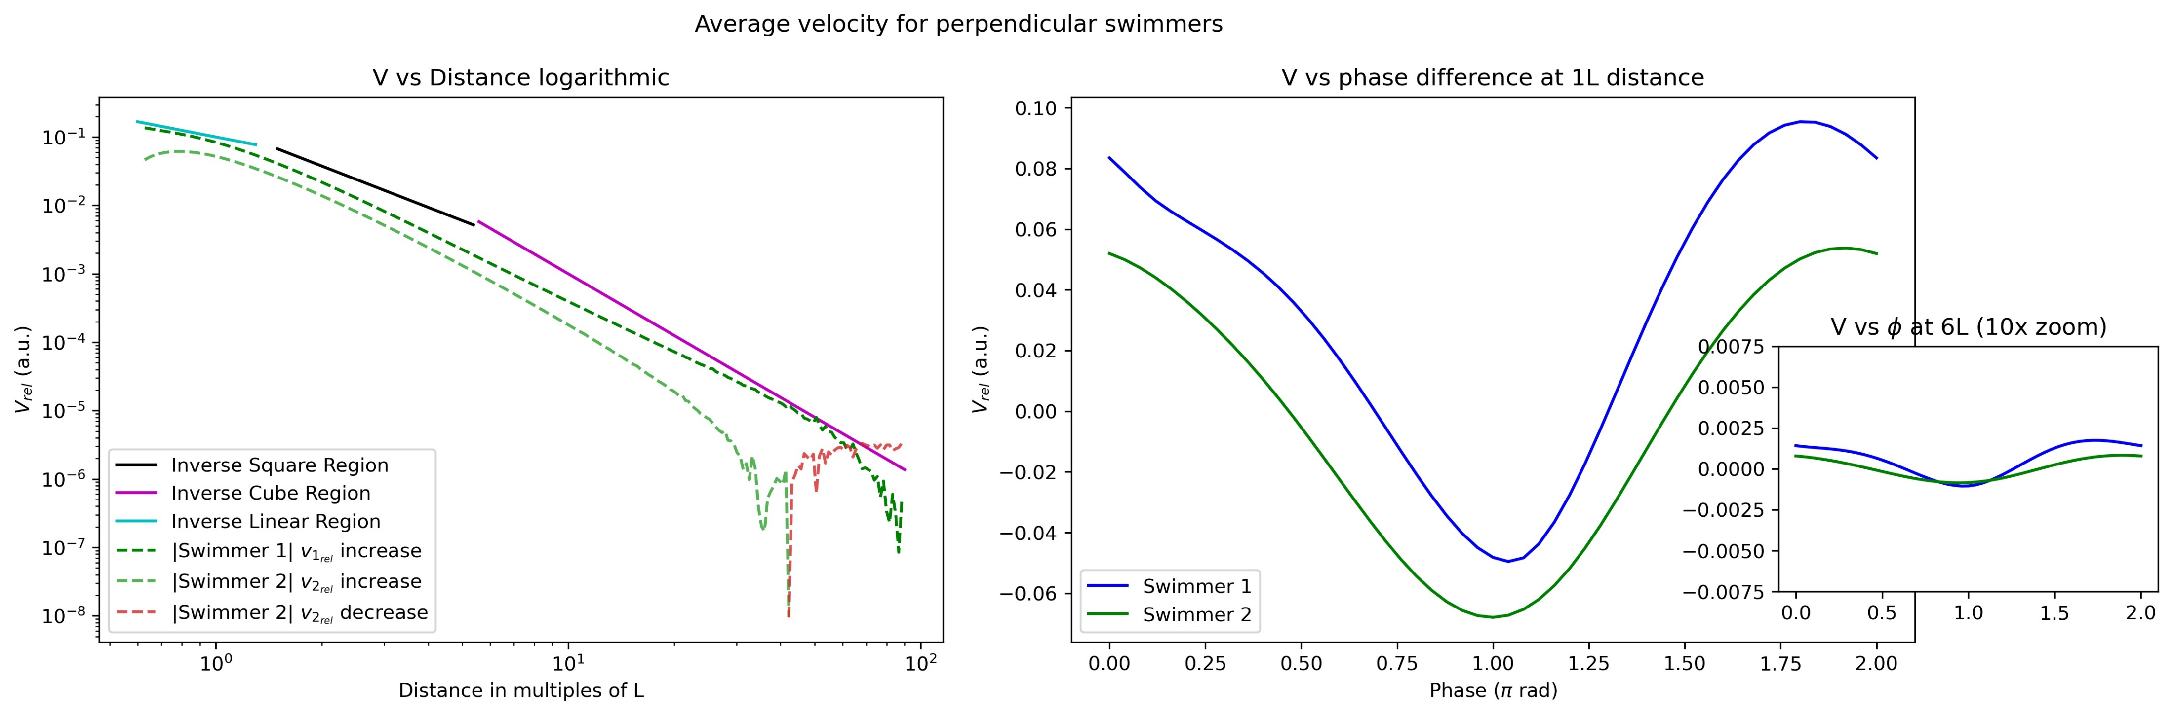
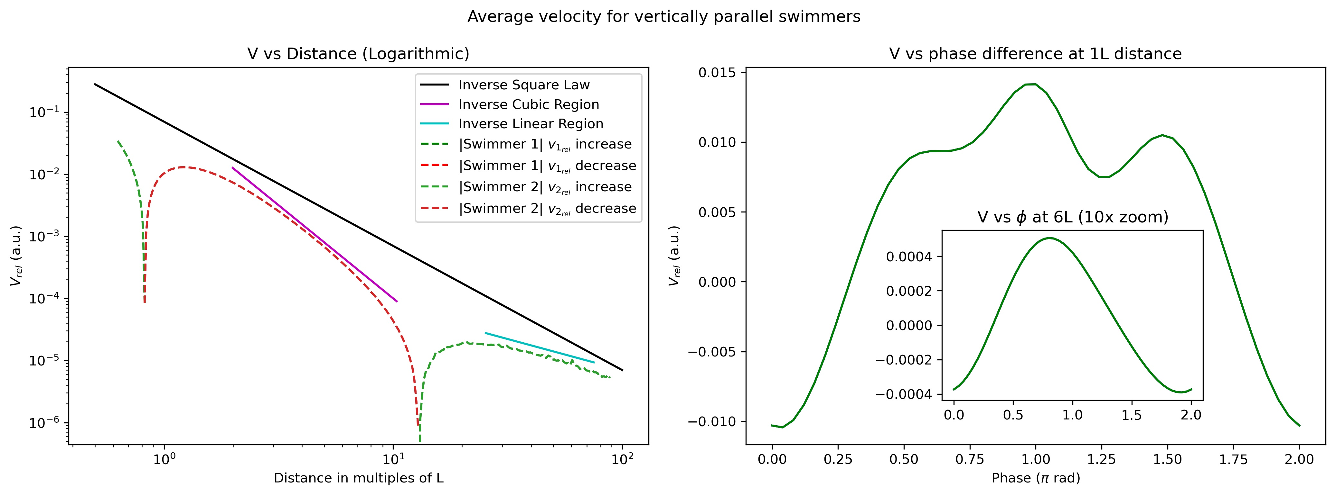
Results
Interaction Strength
Perpendicular
Parallel side-by-side
Vertically parallel

Slide 16
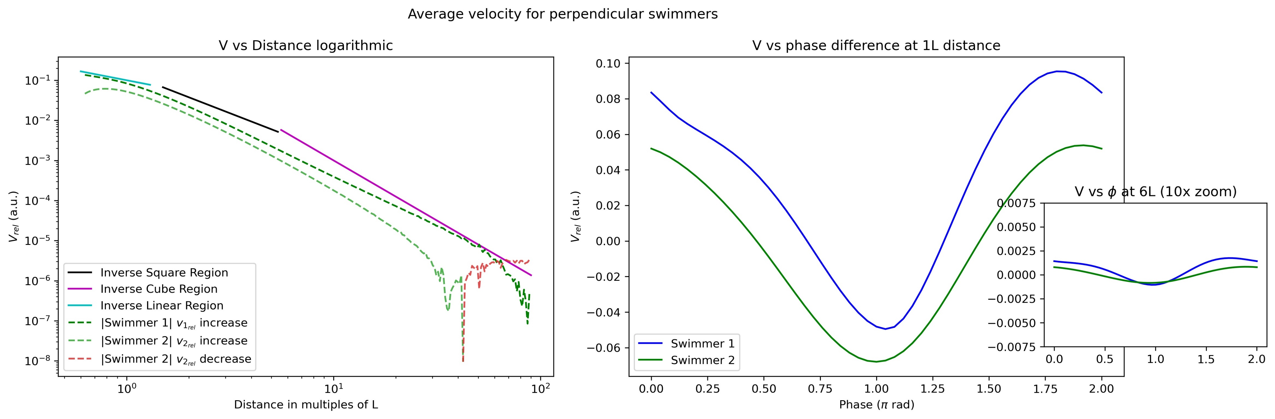
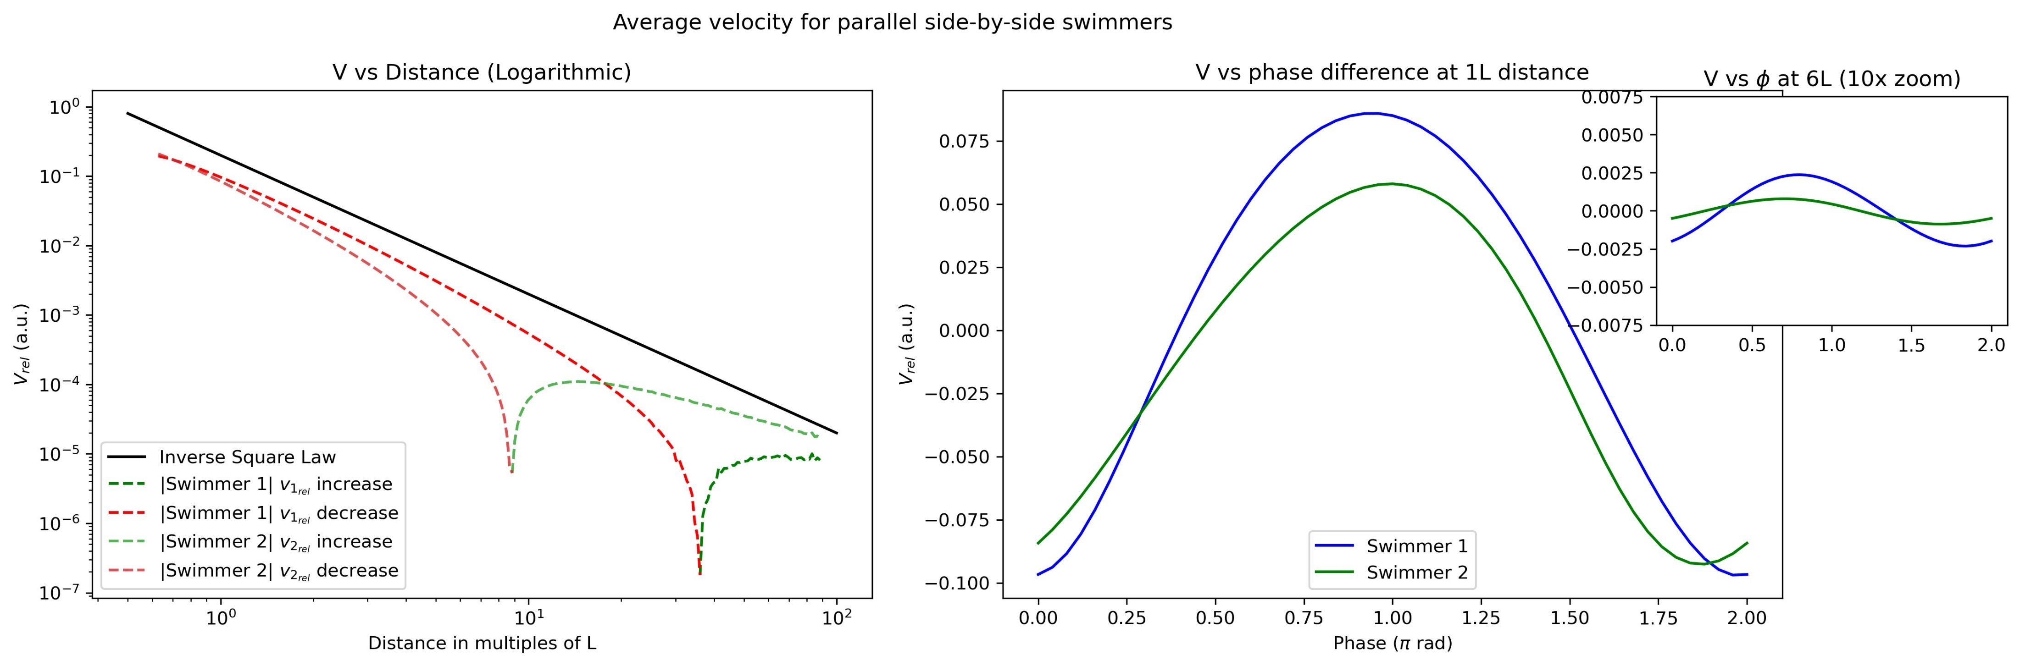
Results
Phase Dependence
Vertically Parallel
Perpendicular
Parallel side-by-side

Slide 17
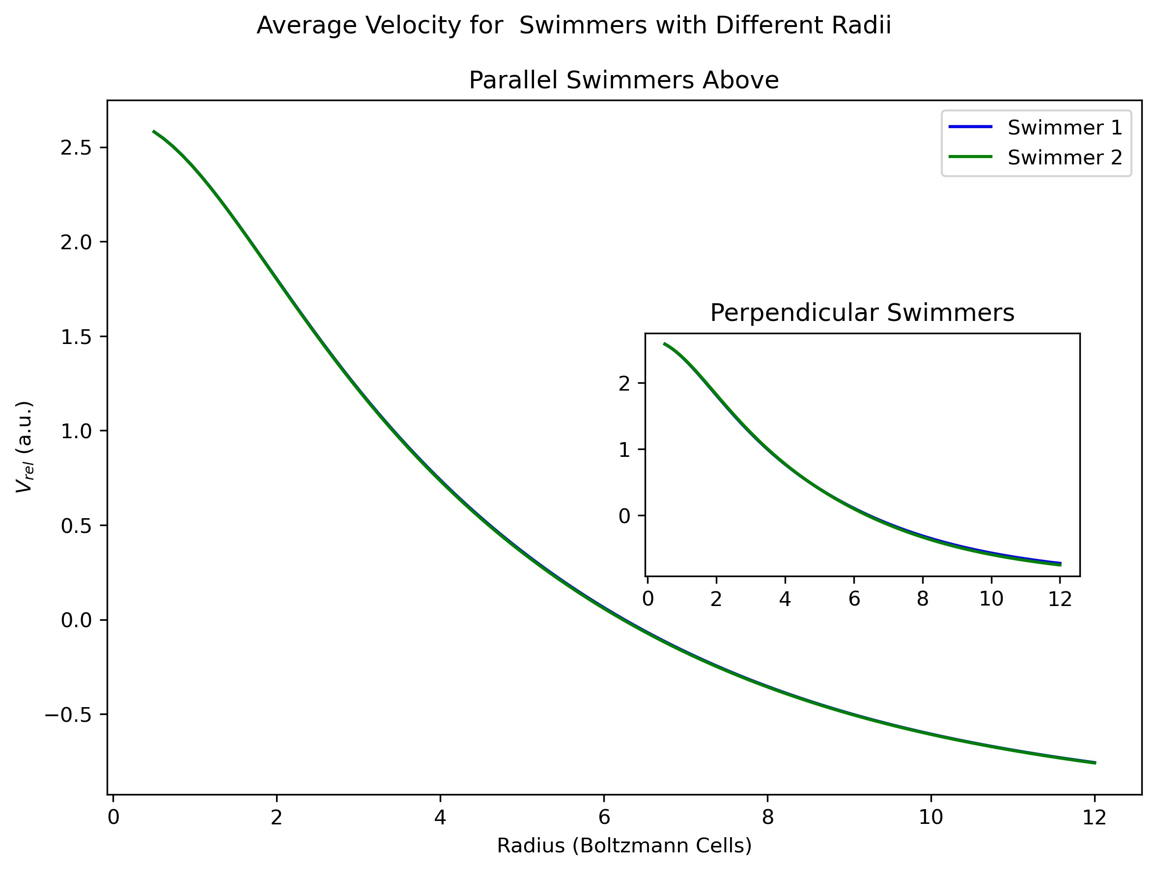
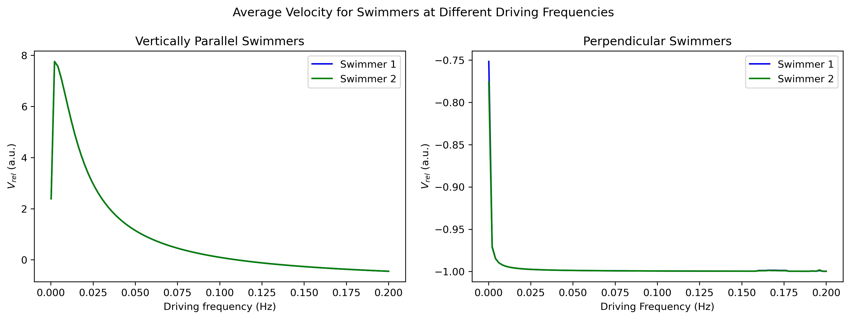
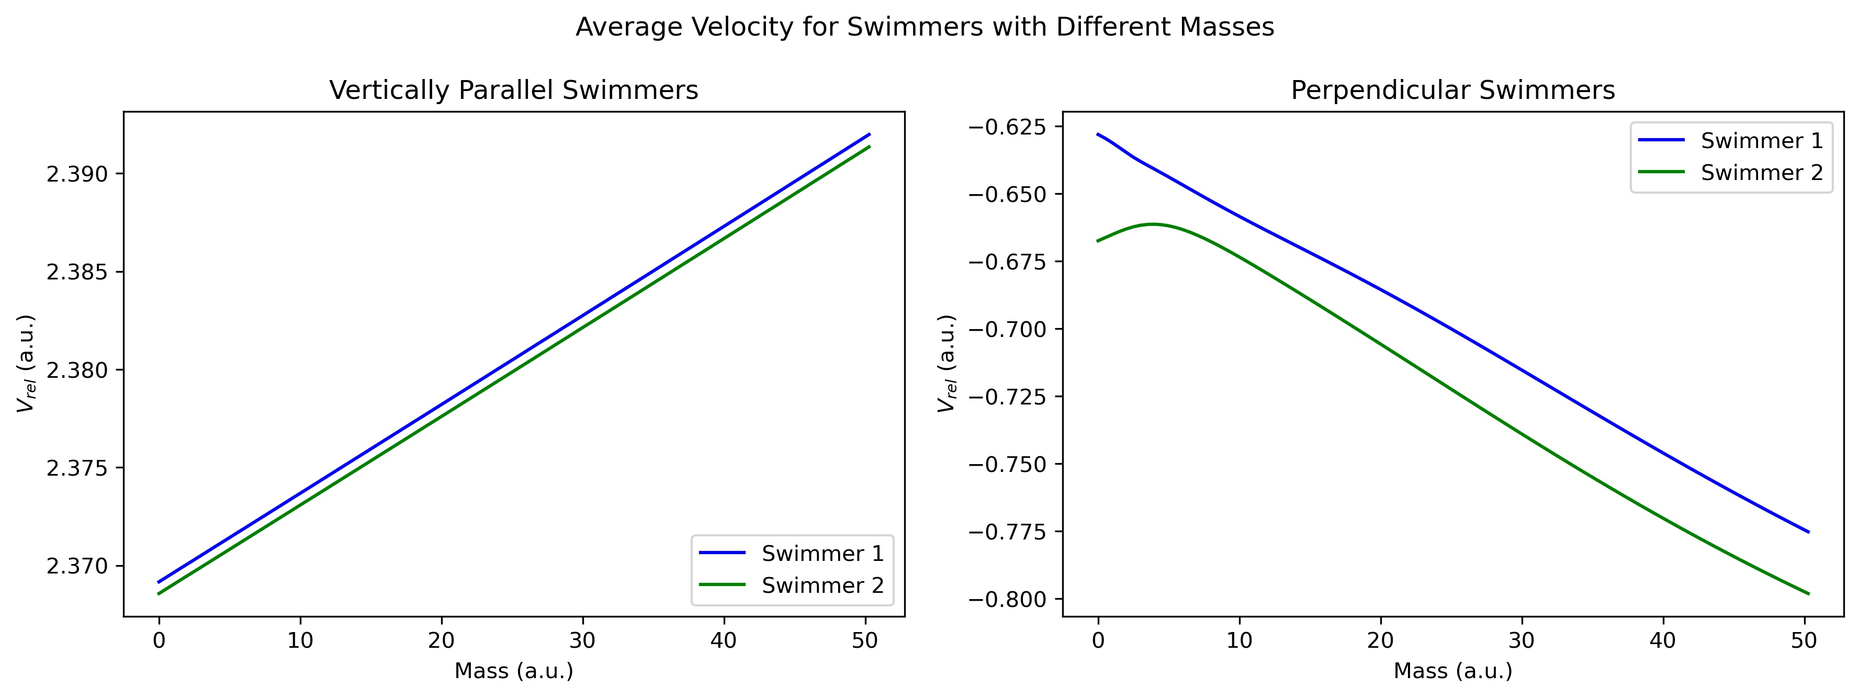
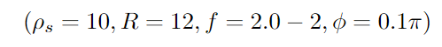


Results
Parameter Sweep
Optimal setup: Vertically Parallel
Worst setup: Perpendicular
$$v_{rel}=7.8$$
$$v_{rel}=−0.99$$

Slide 18
Conclusions
The interaction between swimmers is highly dependent on distance and phase.
The interaction can be constructive or cause interference
Mass does not simply increase speed; it amplifies the interaction, both positive and negative
Large regions of inverse square and inverse cubic interaction strengths
Active effects of the relative phase between swimmers strongly influences interaction
Interaction effect highly dependent on configuration and starting parameters
Future considerations:
How does this extend to multiple swimmers in a 3D environment?

Slide 19
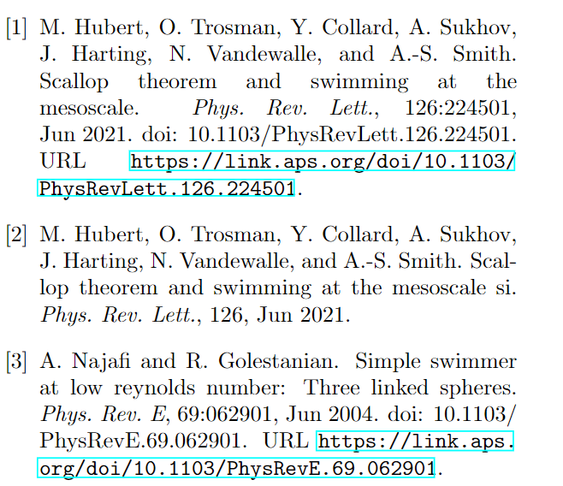
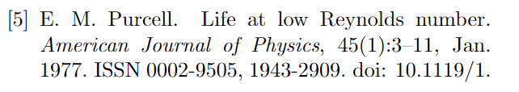
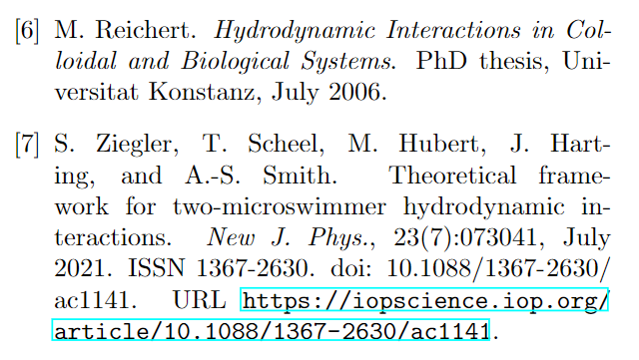
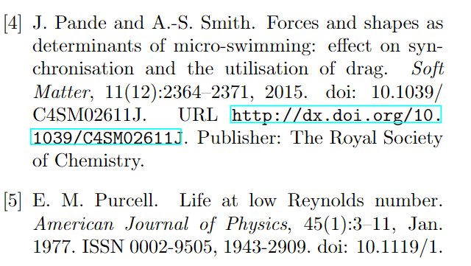
References

Slide 20
Thank you for your time

